Slide 1
final project exploratory analysis
File created on: 11/15/2023 8:24:37 PM

Slide 2
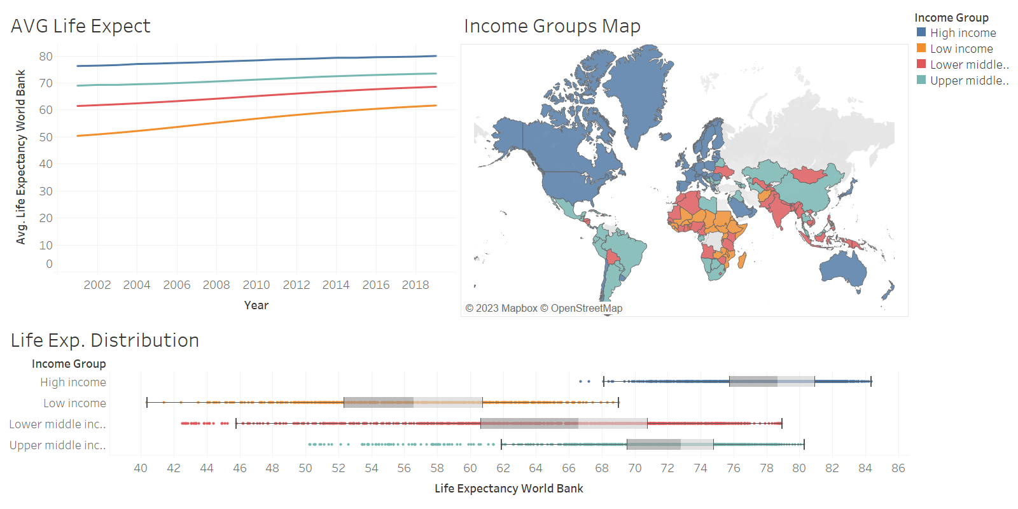

Slide 3
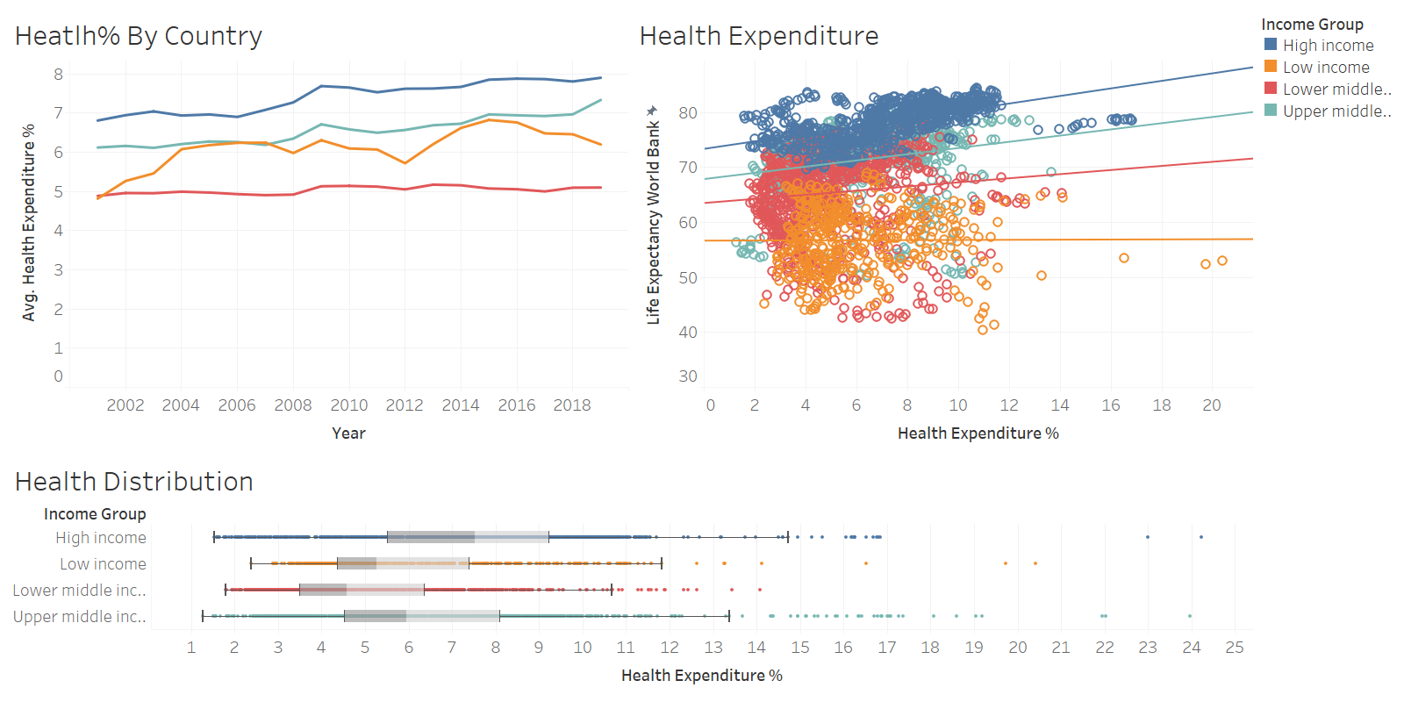

Slide 4
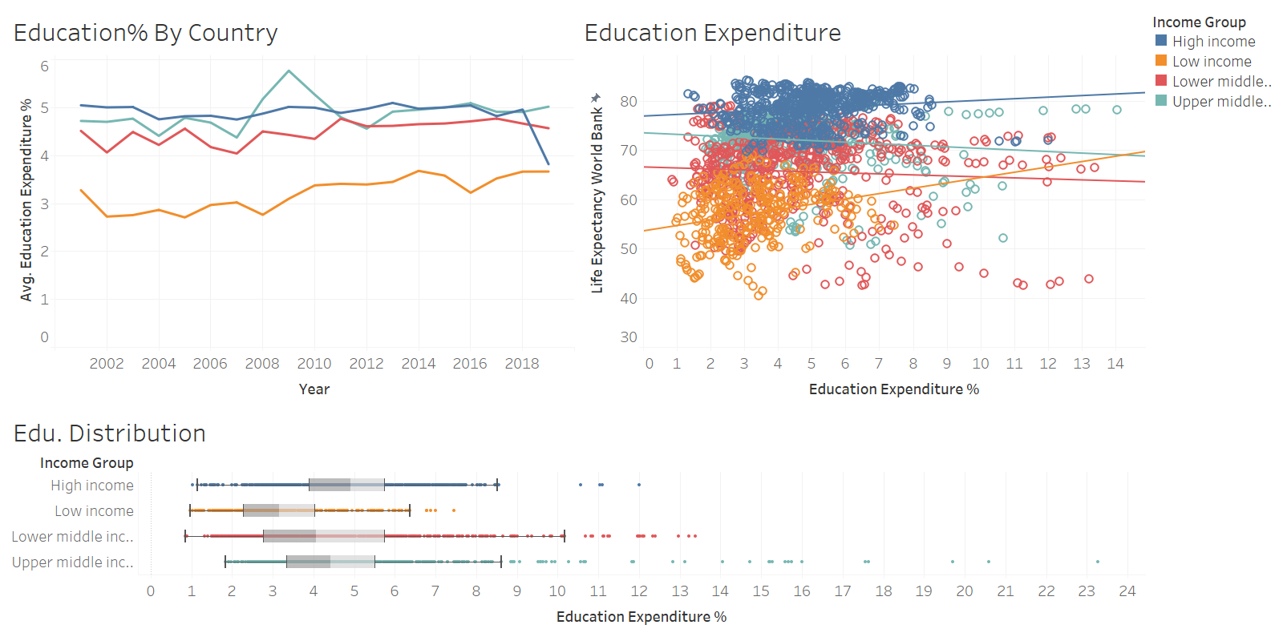

Slide 5
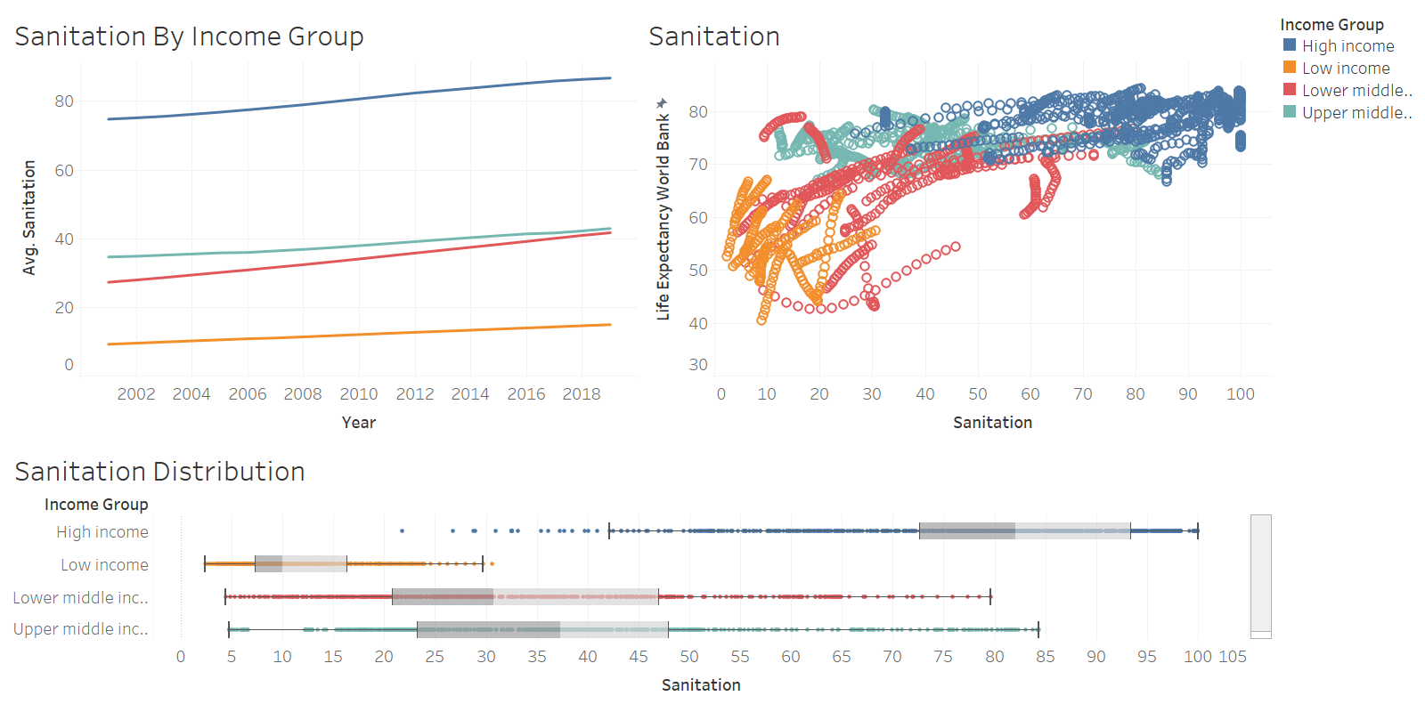

Slide 6
